Slide 1
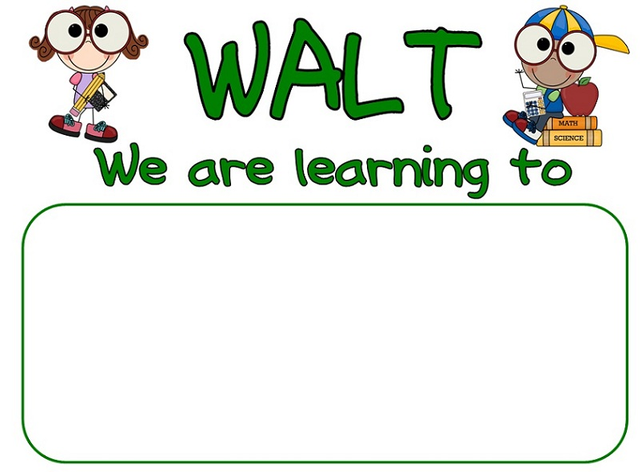

What to do
Read the dreamtime story.
Think about your story.
Retell your story to a partner.
Brainstorm vocabulary from story.
Complete the written retell.
Retell a dreamtime story called the Tiddelick.
I know the beginning, middle and end of the story.
I can retell the story in the correct sequence.
I used my own words.
I know the problem and a solution.
I used vocabulary from the text.

Slide 2
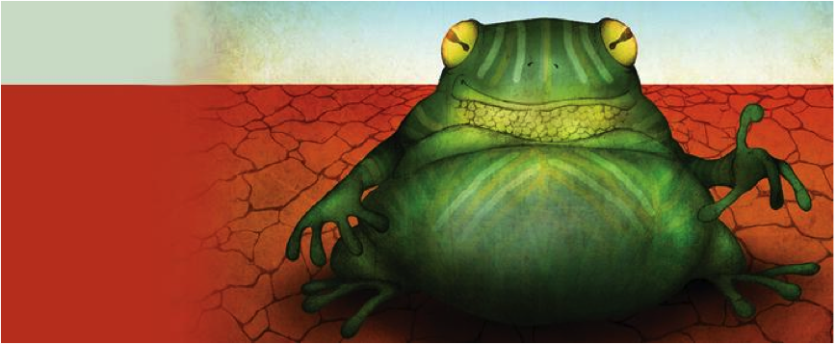
Tiddalick
The Greedy Frog

Slide 3
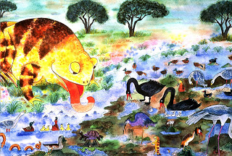
I am a greedy frog!
Long ago in the Dreamtime, Tiddalick, the largest frog ever known, awoke one morning with a huge thirst. He started to drink and drank until there was no fresh water left in the world.

Slide 4
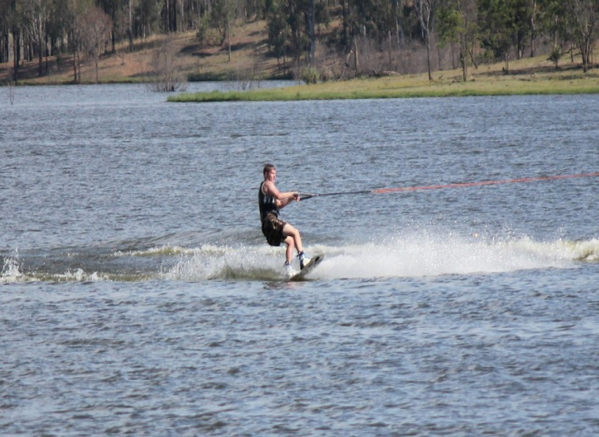
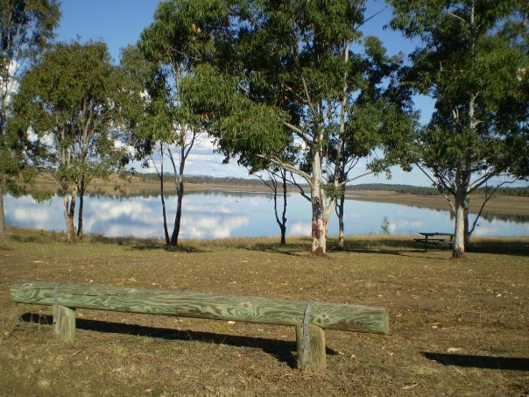
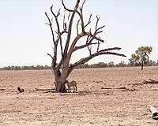
Full
Drying up
Empty
Soon creatures everywhere were dying and trees were wilting because of the lack of moisture.

Slide 5
When all the water has gone, what do we say we are in?
DROUGHT

Slide 6
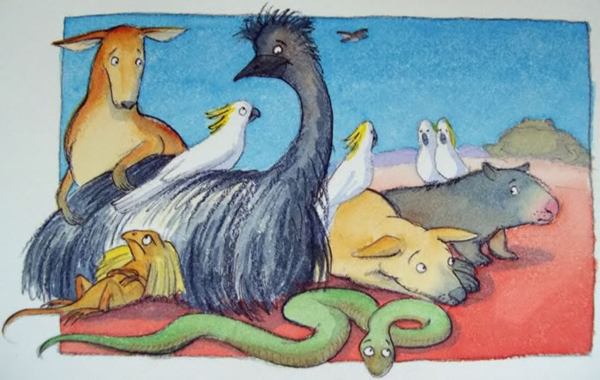
Lets make Tiddalick laugh!
All the animals pondered about their terrible plight until a wise old wombat suggested that if Tiddalick could be made to laugh then maybe all the water would flow out of his mouth. This was a good idea the animals agreed.

Slide 7
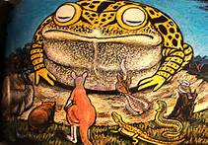
The animals gathered by Tiddalick's resting place and tried for a long time to make him laugh, but it was in vain.
The kookaburra told his funniest story, the kangaroo jumped over the emu and the lizard waddled up and down on two legs making his stomach stick out but Tiddalick was not amused.
I am not amused!

Slide 8
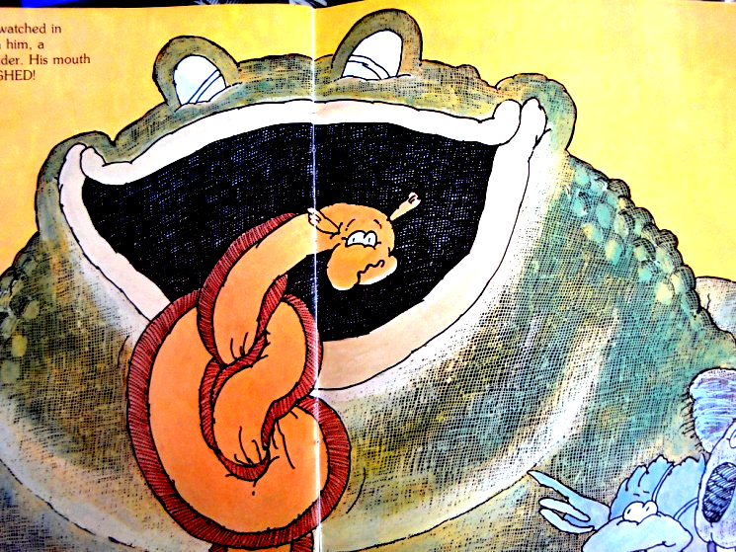
Then when the animals were in despair, Nabunum the eel who was driven from his favourite creek by the drought slid up to the unresponsive frog and began to dance. As the dance got faster Nabunum wriggled and twisted himself into all sorts of knots and shapes to the amusement of Tiddalick.
I’m in a knot!

Slide 9
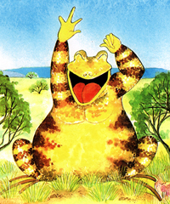
Tiddalick's eyes lit up and burst out laughing.
As he laughed the water gushed out from his mouth and flowed away to replenish the lakes, swamps and rivers again.

Slide 10
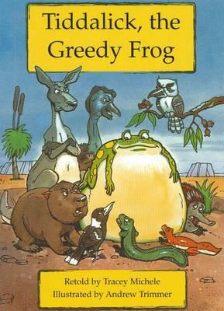

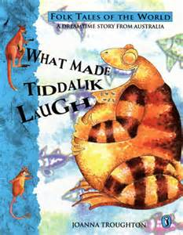

Look at how many different books there are for this story Tiddelick.

Slide 11
Setting
Characters
Tiddalick Brain Storm
STORY WEB
Beginning
Middle
End

Slide 12
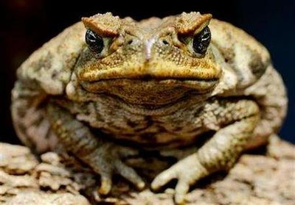
Who is tiddalick?
I’m a large cane toad!
Story by Joanna Troughton
Edited by Sanchia Lane

Slide 13
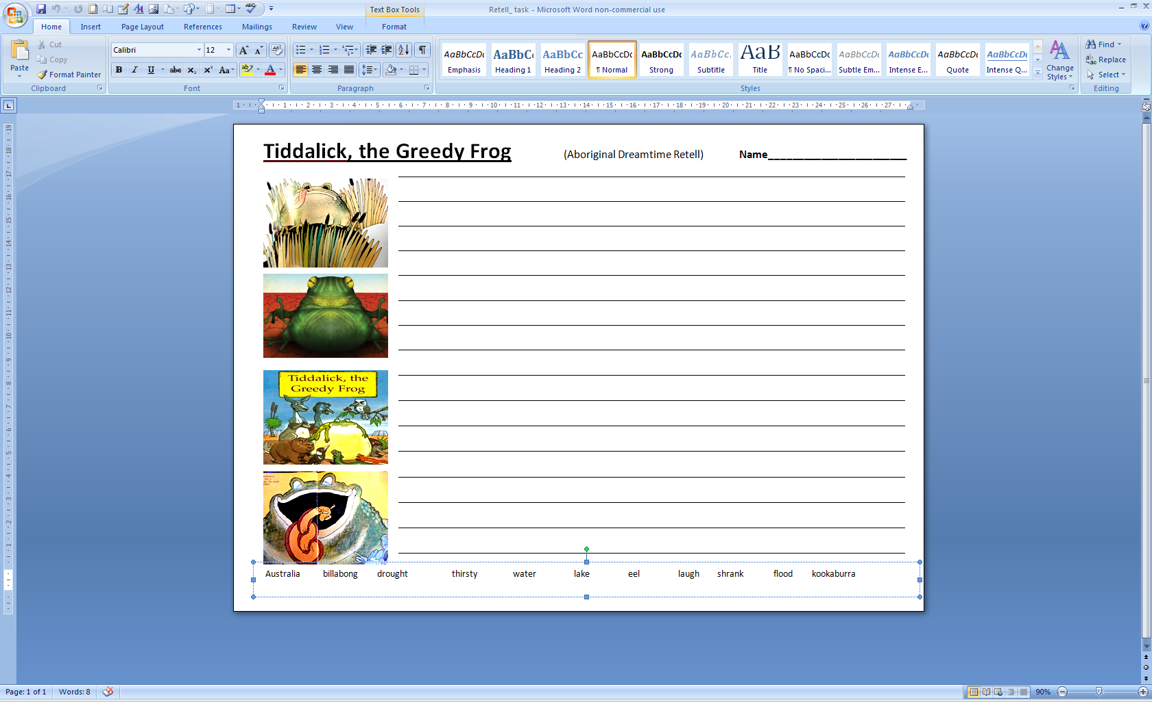
Complete the written retell.
Your worksheet!

